Slide 1
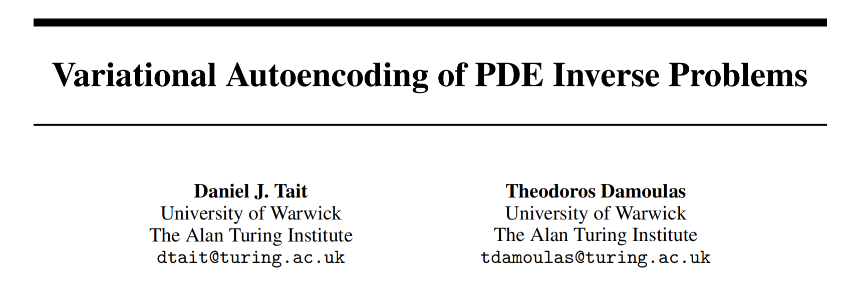
Variational Autoencoding of PDE Inverse Problems

Slide 2
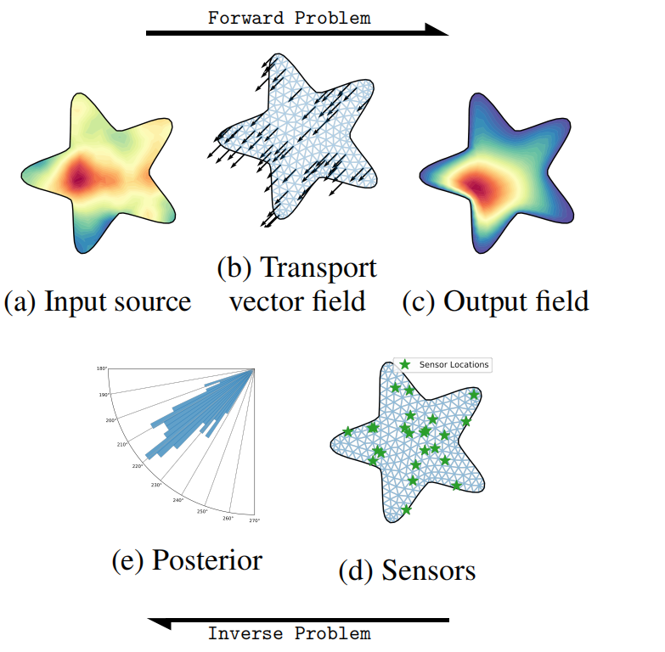
Problem Background
In the forward problem a noisy source (a), for example a pollutant, is convolved with some transporting vector field, (b), such as wind direction, to produce a smoothed output in a bounded domain (c).
The Bayesian inverse problem uses information from a finite number of sensor locations (d) to recover the posterior distribution of the parameters of the forward map, in this instance the posterior direction vectors (e).

Slide 3
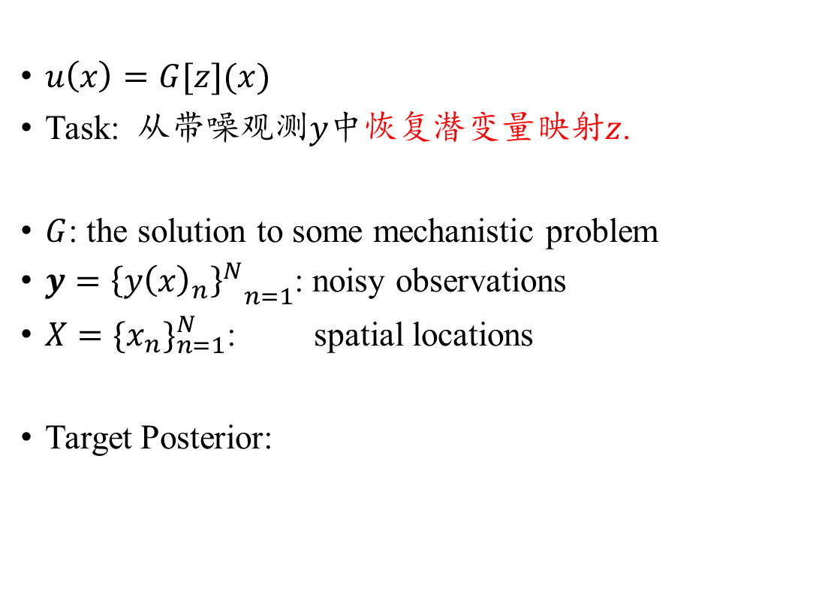
Problem Background – General Form
$u\left(x\right)=G[z](x)$
Task: 从带噪观测$y$中恢复潜变量映射$z$.
$G$: the solution to some mechanistic problem
$y={{\left\{y{\left(x\right)}_{n}\right\}}^{N}}_{n=1}$: noisy observations
$X={\{x_{n}\}}_{n=1}^{N}$: spatial locations
Target Posterior:

Slide 4
Problem Background – PDE Form
We focus on a particular instance of the BIP by examining forward maps which arise as the implicit solutions of PDEs.
L[z] : differential operator parameterised by z.
f(x): the source term of PDE inputs
g(x): the boundary condition

Slide 5
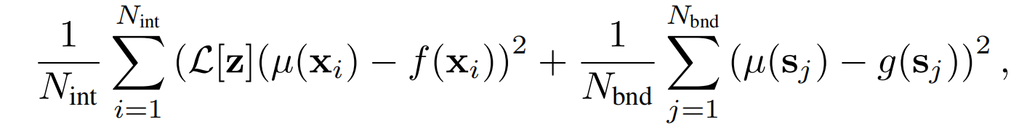

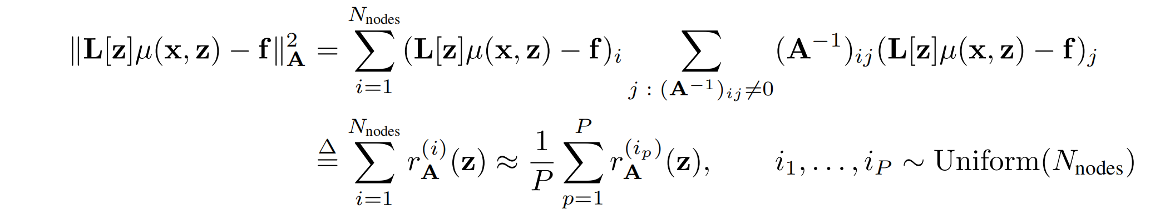
Main Method
1st : Apply the FEM weak-form constraint
2: Use MC approximation :

Slide 6
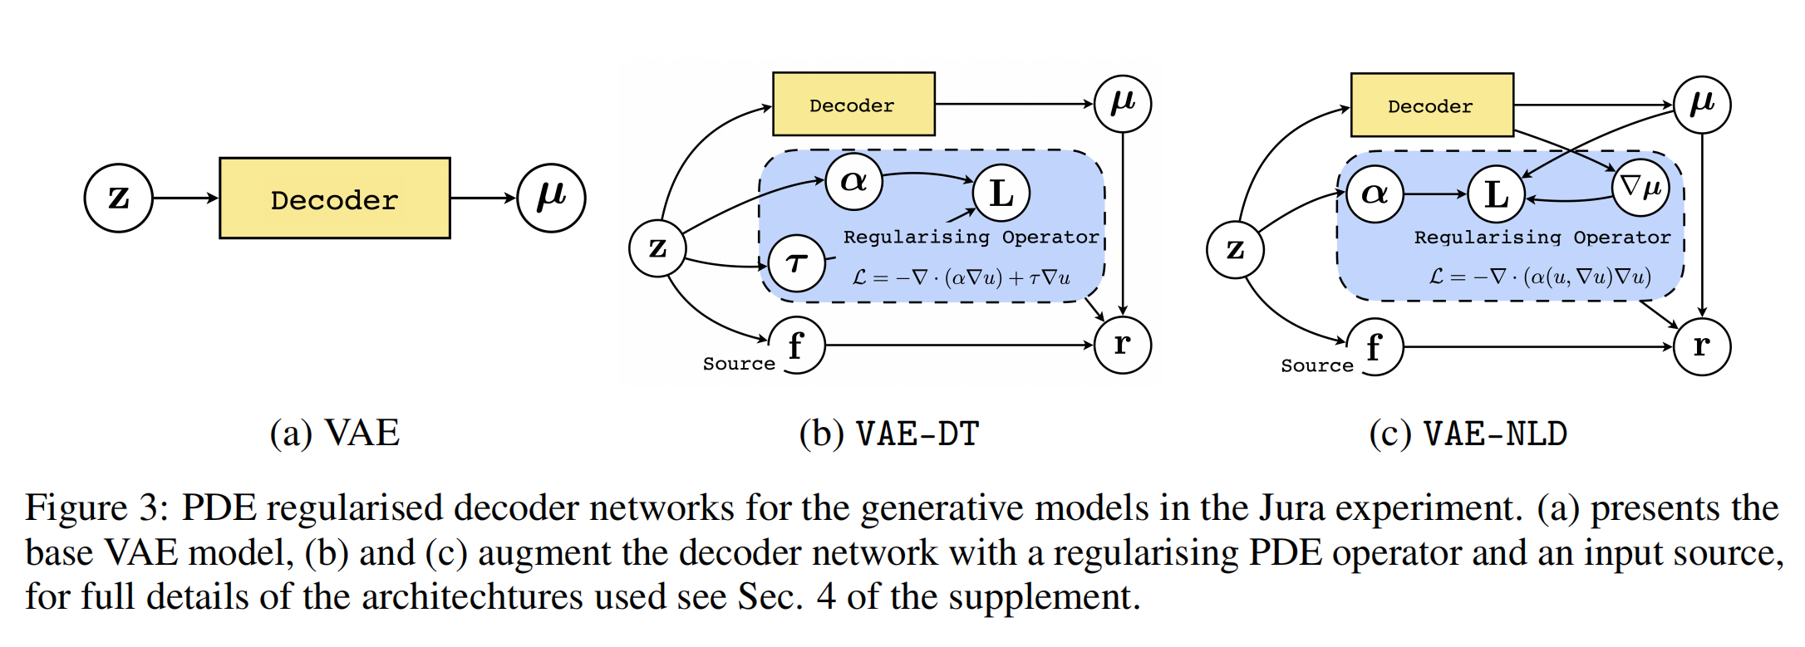
Main Method
通过最小化变分分布 𝑞(𝑧) 和变分参数 𝜇 来解决贝叶斯逆问题（BIP），同时使用有限元法（FEM）中的弱形式约束作为正则化项。

